Slide 1
AI 2002: Artificial Intelligence
Machine Learning
(Decision Tree)
Spring 2026
[These slides (mostly) are based on those created by Dan Klein and Pieter Abbeel (ai.berkeley.edu).]
[Some slides are by Mr. Sandesh Kumar, and Ms. Anaum Hamid, FAST-NUCES, Karahi, and by Nitin Agarwal, Software Consultant]

Slide 2

Decision Trees
Compact representation of a function
Can express any function of the features
Features, aka attributes
Truth table
Conditional probability table
Regression values
Notes:
Can’t represent xor with linear classifiers like perceptrons.

Slide 3
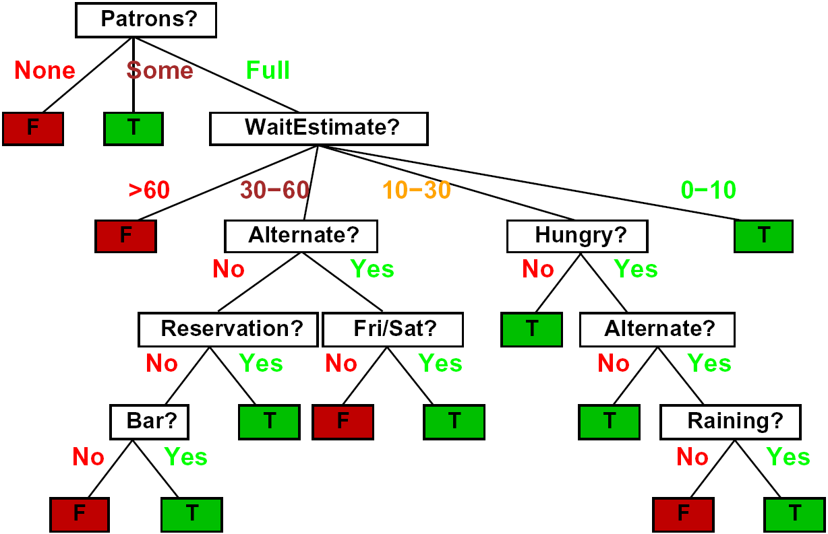
Decision Trees
Notes:
Could also make this probabilistic (probabilities at leaves).

Slide 4
Comparison: Perceptrons
What is the expressiveness of a perceptron over these features?
For a perceptron, a feature’s contribution is either positive or negative
If you want one feature’s effect to depend on another, you have to add a new conjunction feature
E.g. adding “PATRONS=full ∧ WAIT = 60” allows a perceptron to model the interaction between the two atomic features
DTs automatically conjoin features / attributes
Features can have different effects in different branches of the tree!
Notes:
Cannot represent non-linear fucntions with perceptrons, need interaction terms. Decision trees are more comparable to NNs because they can capture non-linearities.

Slide 5
Choosing an Attribute
Idea: a good attribute splits the examples into subsets that are (ideally) “all positive” or “all negative”
So: we need a measure of how “good” a split is, even if the results aren’t perfectly separated out

Slide 6
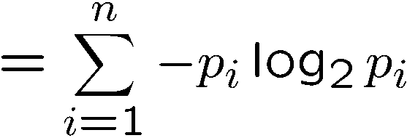
Entropy
General answer: if prior is <p₁,…,p_{n}>:
Information is the expected code length
Also called the entropy of the distribution
More uniform = higher entropy
More values = higher entropy
More peaked = lower entropy
Rare values almost “don’t count”
1 bit
0 bits
0.5 bit

Slide 7
Information Gain
For each split, compare entropy before and after
Difference is the information gain
Problem: there’s more than one distribution after split!
Solution: use expected entropy, weighted by the number of examples
Notes:
Entropy is low for peaky distributions, so rewards splits that create a lot of homogenous groups.

Slide 8
Example: Miles Per Gallon
40 Examples

Slide 9
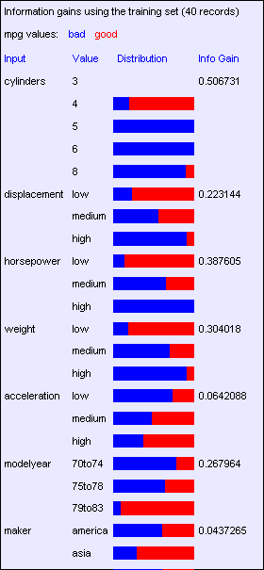
Find the First Split
Look at information gain for each attribute
Note that each attribute is correlated with the target!
What do we split on?

Slide 10
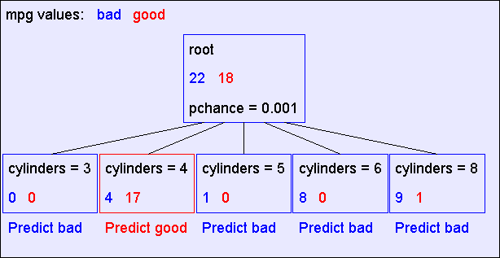
Result: Decision Stump

Slide 11
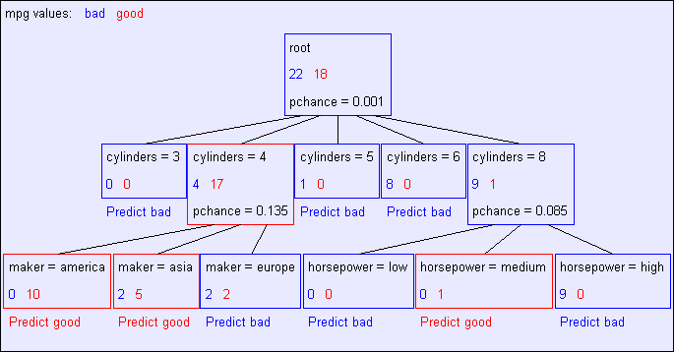
Second Level

Slide 12
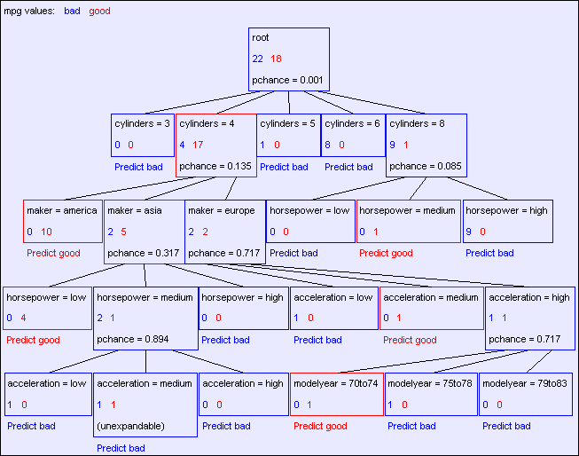
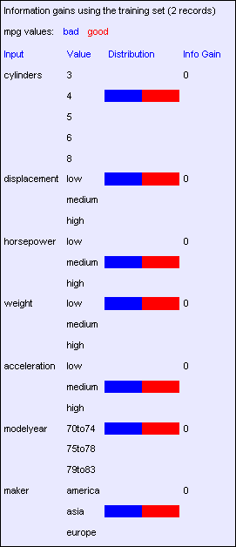
Final Tree
Notes:
Unexpandable – no matter what we split on, doesn’t improve the situation.
We’ve probably overfit at this point – not much data but a very complex tree that almost perfectly fits it.

